Slide 1
Business Analytics and
Big Data Systems
Advanced Data Management
Moscow 2023
DATA INFRASTRUCTURE FOR MUSIC STREAMING SERVICE
Ivan Eremenko
Olga Goldobina
Vlad Maslennikov
Diana Shabanova

Slide 2
Intro
Business Analytics and Big Data Systems
Cloud-based data processing platforms
Moscow 2023

Slide 3

What is music streaming service?
Business Analytics and Big Data Systems
Advanced Data Management
Data infrastructure for music streaming services
A music streaming service is a platform or application that allows users to listen to music online without the need to download or own the music files. It provides a vast library of songs from various artists, genres, and albums that users can access and stream on-demand.

Slide 4


The biggest players in the global market
Business Analytics and Big Data Systems
Advanced Data Management
Data infrastructure for music streaming services
170 million paid subscribers
72 million paid subscribers
VS

Slide 5


The biggest players in the Russian market
Business Analytics and Big Data Systems
Advanced Data Management
Data infrastructure for music streaming services
11 million paid subscribers
2,5 million paid subscribers

Slide 6
Business model
Business Analytics and Big Data Systems
Cloud-based data processing platforms
Moscow 2023

Slide 7
Business Analytics and Big Data Systems
Data infrastructure for music streaming services
Business model
Value Proposition:
Access to a vast music library: Users can access a large collection of songs, albums, and playlists across various genres and artists.
Convenience and mobility: Users can stream music on-demand anytime, anywhere, using various devices such as smartphones, tablets, and computers.
Revenue Streams:
Subscription fees: Users can pay a monthly or annual subscription fee to access the full features of the streaming service, including ad-free listening, offline playback, and higher audio quality.
Notes:
Step 1: Collection
The collection of raw data is the first step of the data processing cycle. The type of raw data collected has a huge impact on the output produced. Hence, raw data should be gathered from defined and accurate sources so that the subsequent findings are valid and usable. Raw data can include monetary figures, website cookies, profit/loss statements of a company, user behavior, etc.
Step 2: Preparation
Data preparation or data cleaning is the process of sorting and filtering the raw data to remove unnecessary and inaccurate data. Raw data is checked for errors, duplication, miscalculations or missing data, and transformed into a suitable form for further analysis and processing. This is done to ensure that only the highest quality data is fed into the processing unit.
The purpose of this step to remove bad data (redundant, incomplete, or incorrect data) so as to begin assembling high-quality information so that it can be used in the best possible way for business intelligence.
Step 3: Input
In this step, the raw data is converted into machine readable form and fed into the processing unit. This can be in the form of data entry through a keyboard, scanner or any other input source.
Step 4: Data Processing
In this step, the raw data is subjected to various data processing methods using machine learning and artificial intelligence algorithms to generate a desirable output. This step may vary slightly from process to process depending on the source of data being processed (data lakes, online databases, connected devices, etc.) and the intended use of the output.
Also Read: Top 10 Machine Learning Algorithms For Beginners
Step 5: Output
The data is finally transmitted and displayed to the user in a readable form like graphs, tables, vector files, audio, video, documents, etc. This output can be stored and further processed in the next data processing cycle.
Step 6: Storage
The last step of the data processing cycle is storage, where data and metadata are stored for further use. This allows for quick access and retrieval of information whenever needed, and also allows it to be used as input in the next data processing cycle directly.

Slide 8
Business Analytics and Big Data Systems
Data infrastructure for music streaming services
Business model
3. Content Acquisition and Licensing:
Licensing agreements: The service negotiates licensing deals with music labels, publishers, and artists to obtain the rights to stream their music catalog.
4. Technology Infrastructure:
Music streaming platform: The service operates a robust and scalable platform that can handle millions of users simultaneously, ensuring smooth streaming and reliable user experience.
5. Data Analytics and Advertising:
User data analysis: The service leverages user data such as playlist info, track info, user info, subscription info.
Notes:
Step 1: Collection
The collection of raw data is the first step of the data processing cycle. The type of raw data collected has a huge impact on the output produced. Hence, raw data should be gathered from defined and accurate sources so that the subsequent findings are valid and usable. Raw data can include monetary figures, website cookies, profit/loss statements of a company, user behavior, etc.
Step 2: Preparation
Data preparation or data cleaning is the process of sorting and filtering the raw data to remove unnecessary and inaccurate data. Raw data is checked for errors, duplication, miscalculations or missing data, and transformed into a suitable form for further analysis and processing. This is done to ensure that only the highest quality data is fed into the processing unit.
The purpose of this step to remove bad data (redundant, incomplete, or incorrect data) so as to begin assembling high-quality information so that it can be used in the best possible way for business intelligence.
Step 3: Input
In this step, the raw data is converted into machine readable form and fed into the processing unit. This can be in the form of data entry through a keyboard, scanner or any other input source.
Step 4: Data Processing
In this step, the raw data is subjected to various data processing methods using machine learning and artificial intelligence algorithms to generate a desirable output. This step may vary slightly from process to process depending on the source of data being processed (data lakes, online databases, connected devices, etc.) and the intended use of the output.
Also Read: Top 10 Machine Learning Algorithms For Beginners
Step 5: Output
The data is finally transmitted and displayed to the user in a readable form like graphs, tables, vector files, audio, video, documents, etc. This output can be stored and further processed in the next data processing cycle.
Step 6: Storage
The last step of the data processing cycle is storage, where data and metadata are stored for further use. This allows for quick access and retrieval of information whenever needed, and also allows it to be used as input in the next data processing cycle directly.

Slide 9
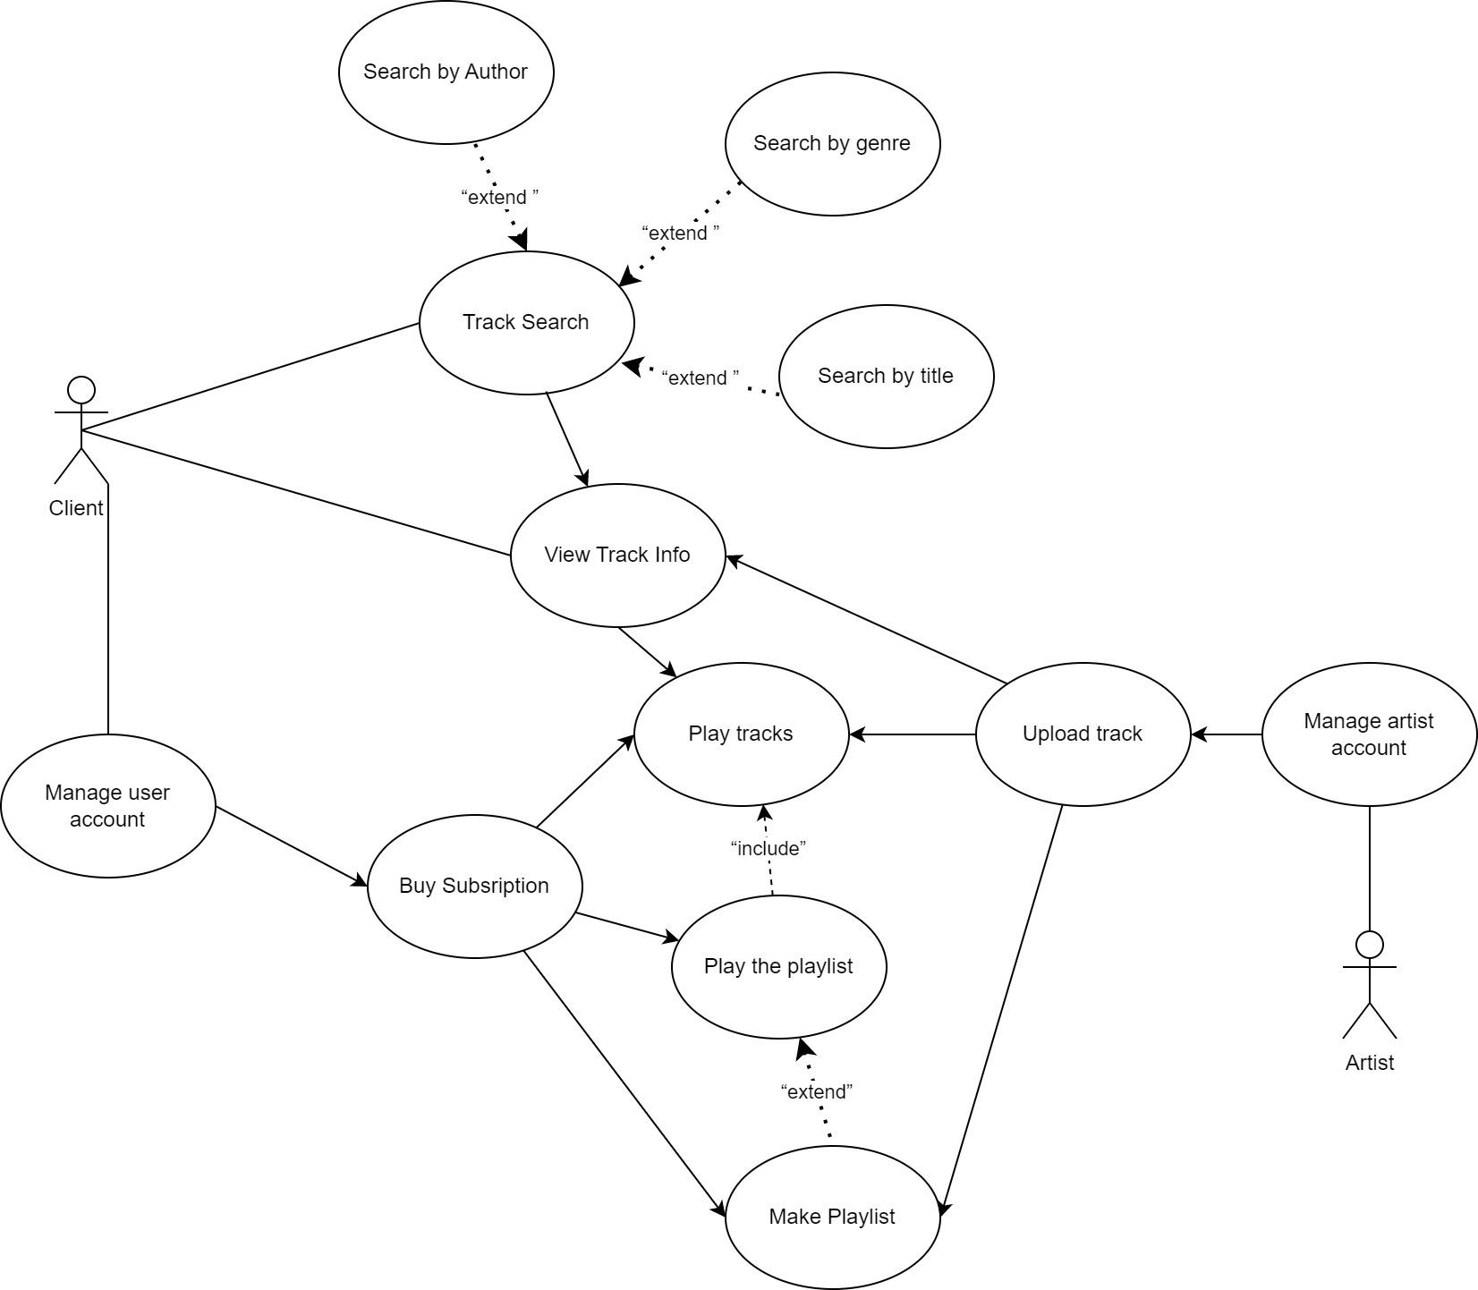
Business Analytics and Big Data Systems
Data infrastructure for music streaming services
Business model
The UML Use-case diagram
Notes:
Step 1: Collection
The collection of raw data is the first step of the data processing cycle. The type of raw data collected has a huge impact on the output produced. Hence, raw data should be gathered from defined and accurate sources so that the subsequent findings are valid and usable. Raw data can include monetary figures, website cookies, profit/loss statements of a company, user behavior, etc.
Step 2: Preparation
Data preparation or data cleaning is the process of sorting and filtering the raw data to remove unnecessary and inaccurate data. Raw data is checked for errors, duplication, miscalculations or missing data, and transformed into a suitable form for further analysis and processing. This is done to ensure that only the highest quality data is fed into the processing unit.
The purpose of this step to remove bad data (redundant, incomplete, or incorrect data) so as to begin assembling high-quality information so that it can be used in the best possible way for business intelligence.
Step 3: Input
In this step, the raw data is converted into machine readable form and fed into the processing unit. This can be in the form of data entry through a keyboard, scanner or any other input source.
Step 4: Data Processing
In this step, the raw data is subjected to various data processing methods using machine learning and artificial intelligence algorithms to generate a desirable output. This step may vary slightly from process to process depending on the source of data being processed (data lakes, online databases, connected devices, etc.) and the intended use of the output.
Also Read: Top 10 Machine Learning Algorithms For Beginners
Step 5: Output
The data is finally transmitted and displayed to the user in a readable form like graphs, tables, vector files, audio, video, documents, etc. This output can be stored and further processed in the next data processing cycle.
Step 6: Storage
The last step of the data processing cycle is storage, where data and metadata are stored for further use. This allows for quick access and retrieval of information whenever needed, and also allows it to be used as input in the next data processing cycle directly.

Slide 10
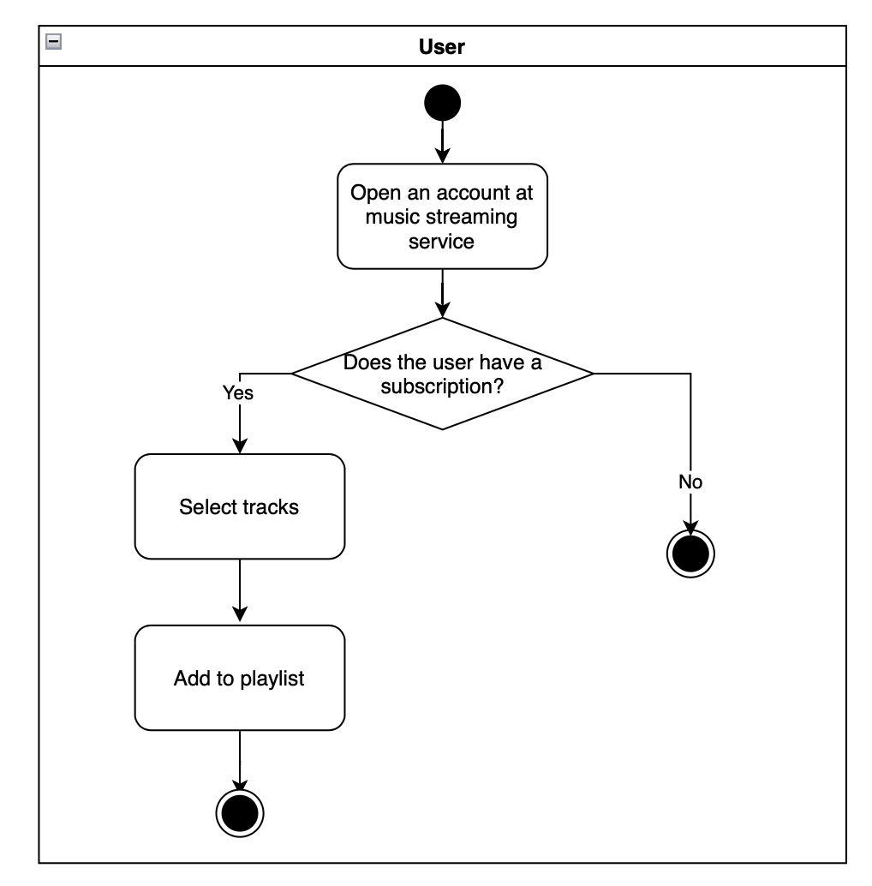
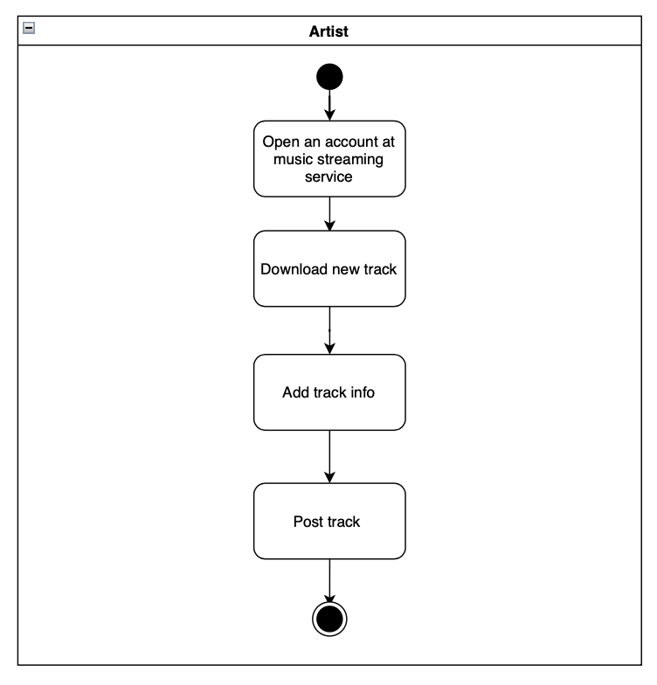
Business Analytics and Big Data Systems
Data infrastructure for music streaming services
Business model
Upload new track
UML activity diagram for making playlist
UML activity diagram for adding track
Notes:
Step 1: Collection
The collection of raw data is the first step of the data processing cycle. The type of raw data collected has a huge impact on the output produced. Hence, raw data should be gathered from defined and accurate sources so that the subsequent findings are valid and usable. Raw data can include monetary figures, website cookies, profit/loss statements of a company, user behavior, etc.
Step 2: Preparation
Data preparation or data cleaning is the process of sorting and filtering the raw data to remove unnecessary and inaccurate data. Raw data is checked for errors, duplication, miscalculations or missing data, and transformed into a suitable form for further analysis and processing. This is done to ensure that only the highest quality data is fed into the processing unit.
The purpose of this step to remove bad data (redundant, incomplete, or incorrect data) so as to begin assembling high-quality information so that it can be used in the best possible way for business intelligence.
Step 3: Input
In this step, the raw data is converted into machine readable form and fed into the processing unit. This can be in the form of data entry through a keyboard, scanner or any other input source.
Step 4: Data Processing
In this step, the raw data is subjected to various data processing methods using machine learning and artificial intelligence algorithms to generate a desirable output. This step may vary slightly from process to process depending on the source of data being processed (data lakes, online databases, connected devices, etc.) and the intended use of the output.
Also Read: Top 10 Machine Learning Algorithms For Beginners
Step 5: Output
The data is finally transmitted and displayed to the user in a readable form like graphs, tables, vector files, audio, video, documents, etc. This output can be stored and further processed in the next data processing cycle.
Step 6: Storage
The last step of the data processing cycle is storage, where data and metadata are stored for further use. This allows for quick access and retrieval of information whenever needed, and also allows it to be used as input in the next data processing cycle directly.

Slide 11
Data modeling
Business Analytics and Big Data Systems
Data infrastructure for music streaming services
Moscow 2023

Slide 12
Business Analytics and Big Data Systems
Data infrastructure for music streaming services
Data modeling
List of core domain entities
Track User Album Artist Genre Playlist Subscription Transaction

Slide 13
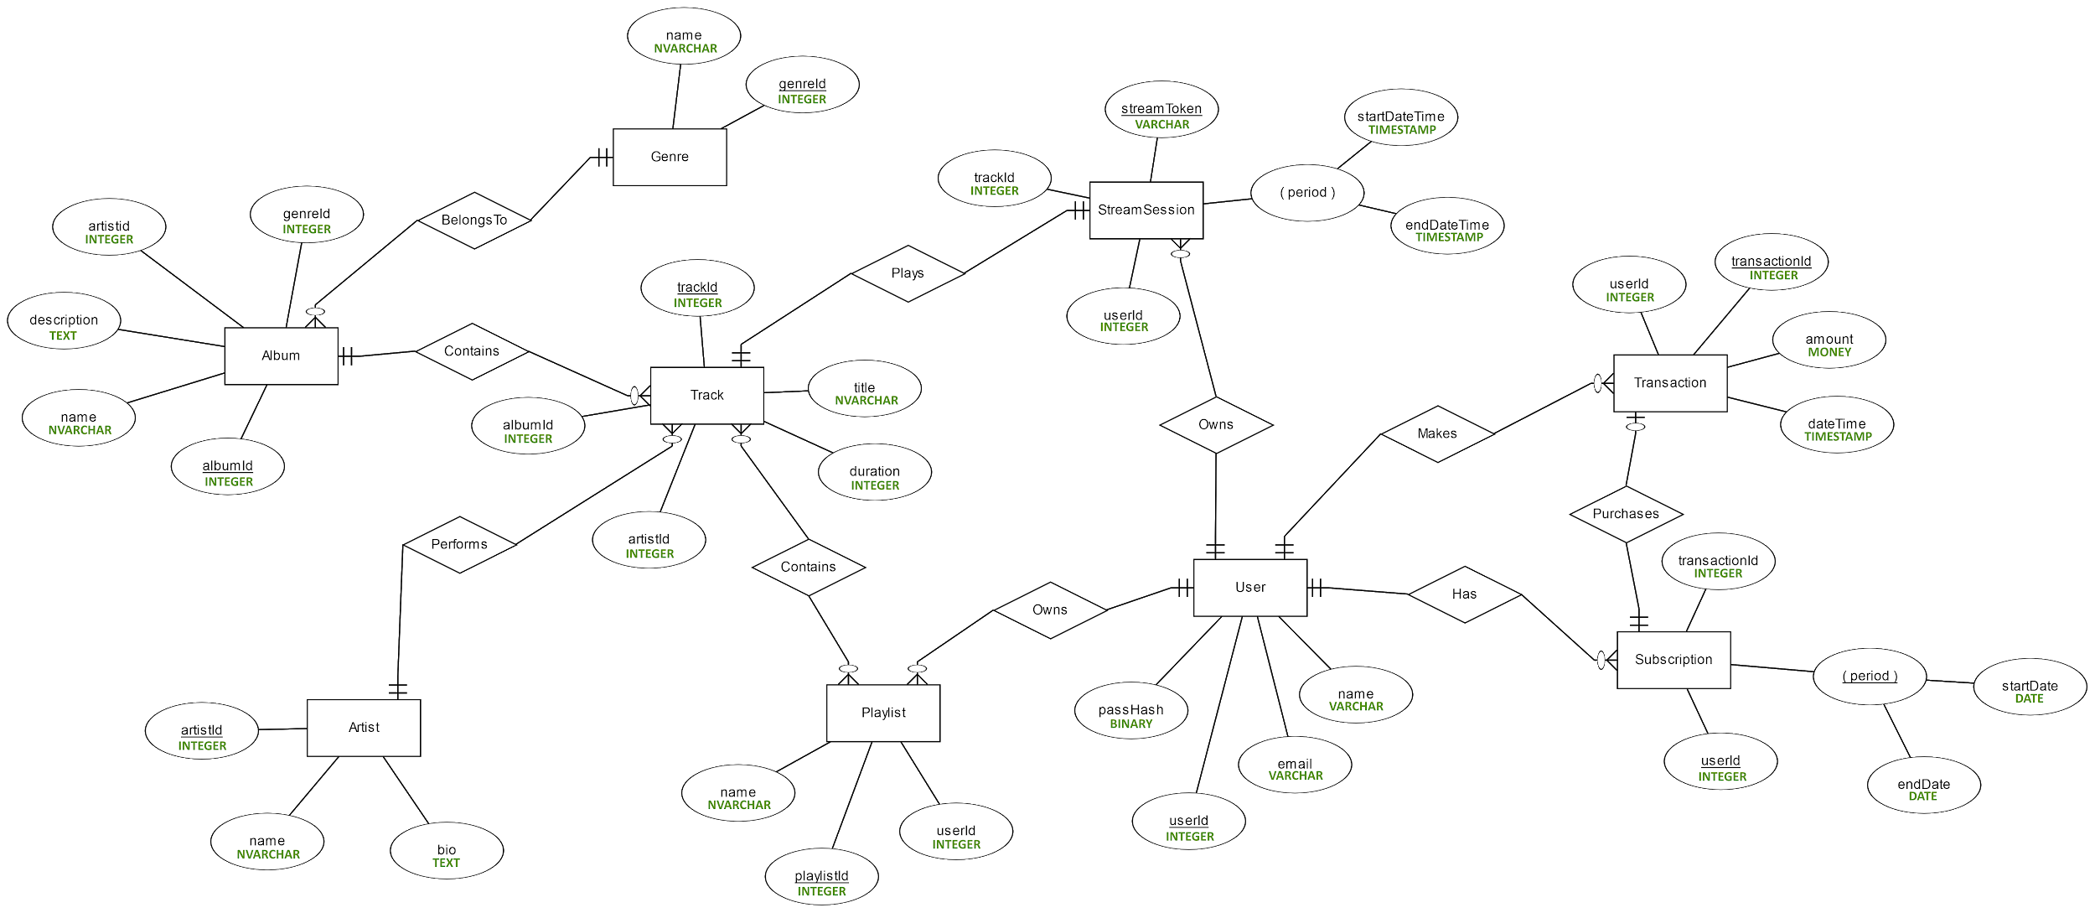
Business Analytics and Big Data Systems
Data infrastructure for music streaming services
Conceptual data model

Slide 14
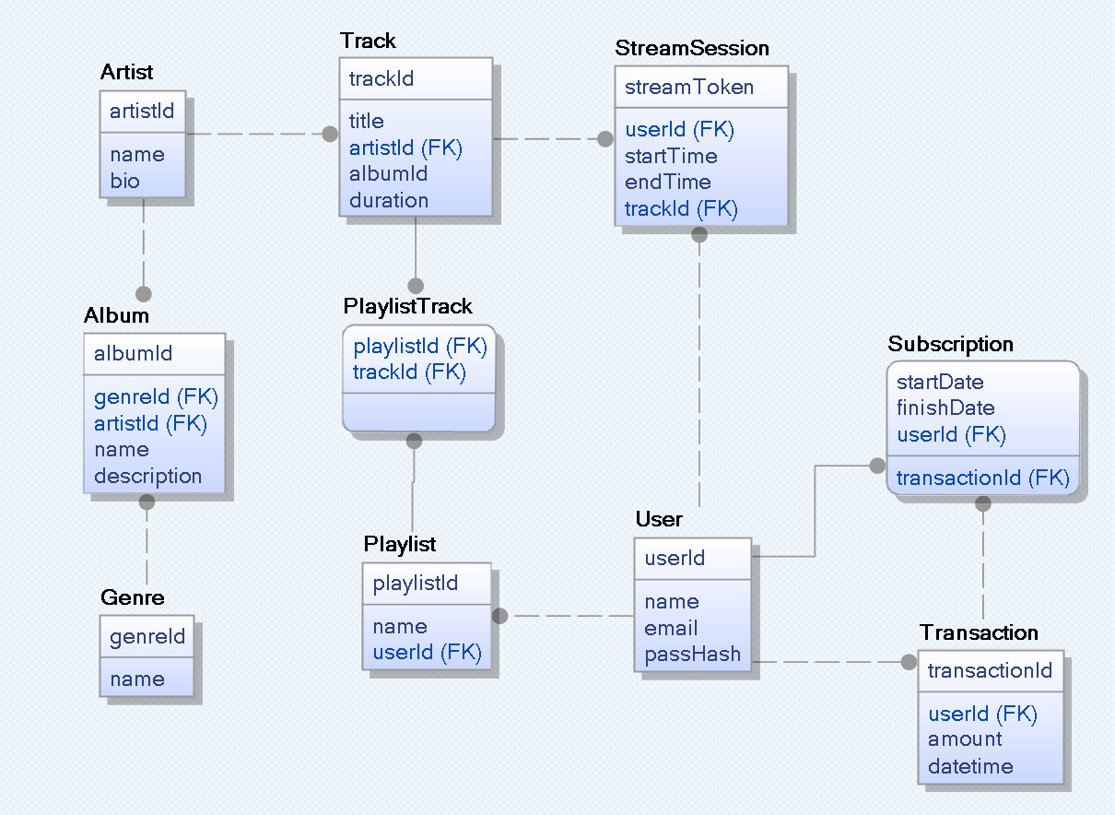
Business Analytics and Big Data Systems
Data infrastructure for music streaming services
Logiacl data model

Slide 15
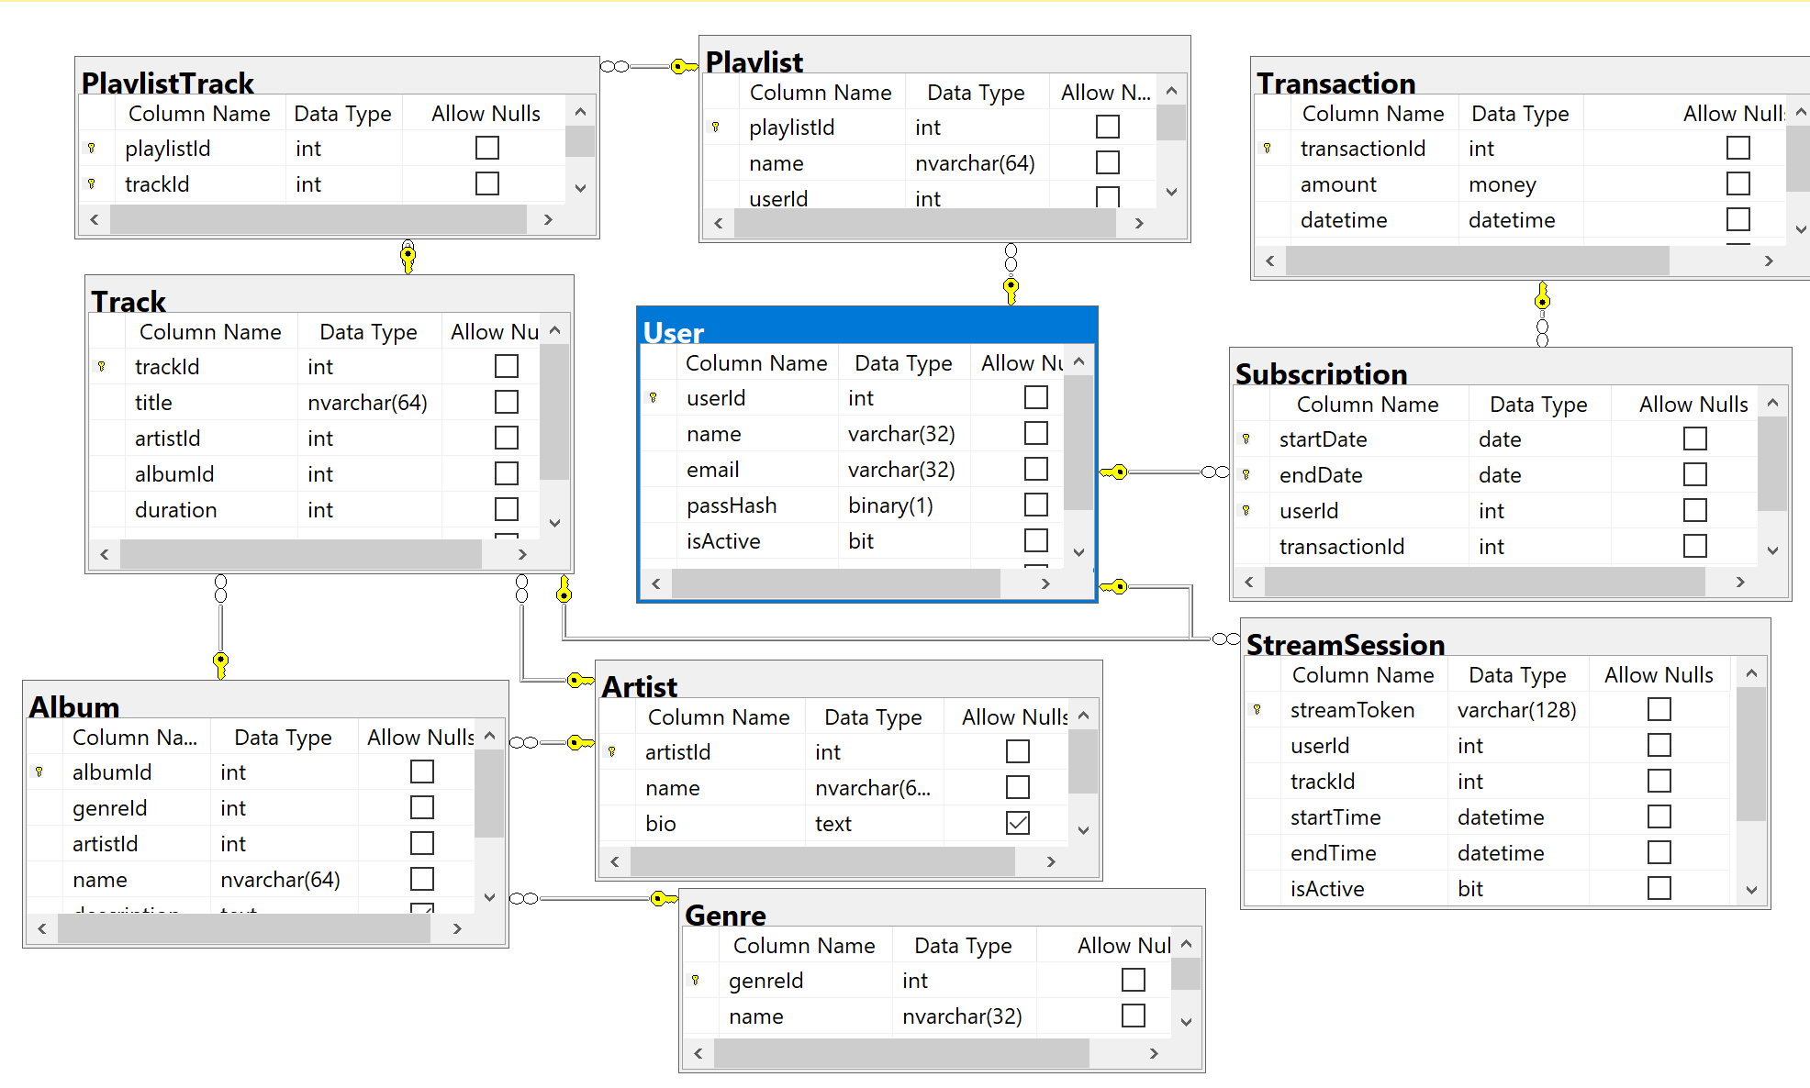
Business Analytics and Big Data Systems
Data infrastructure for music streaming services
Physical data model

Slide 16
Database formation
Business Analytics and Big Data Systems
Data infrastructure for music streaming services
Moscow 2023

Slide 17
Business Analytics and Big Data Systems
Data infrastructure for music streaming services
Database formation
Microsoft SQL Server DBMS
Robust and Stable
Scalability
Security
Integration with Microsoft Ecosystem
Developer-Friendly
High Availability and Disaster Recovery
Support and Community

Slide 18
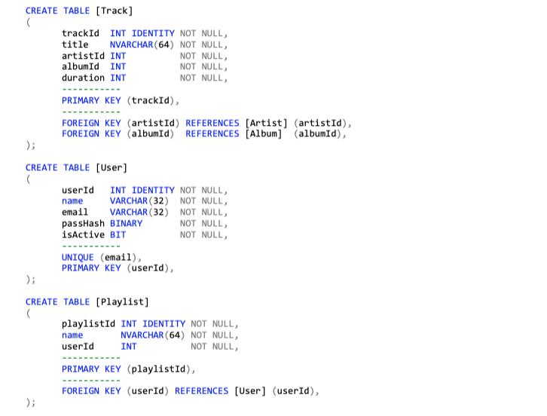
Business Analytics and Big Data Systems
Data infrastructure for music streaming services
Database formation

Slide 19
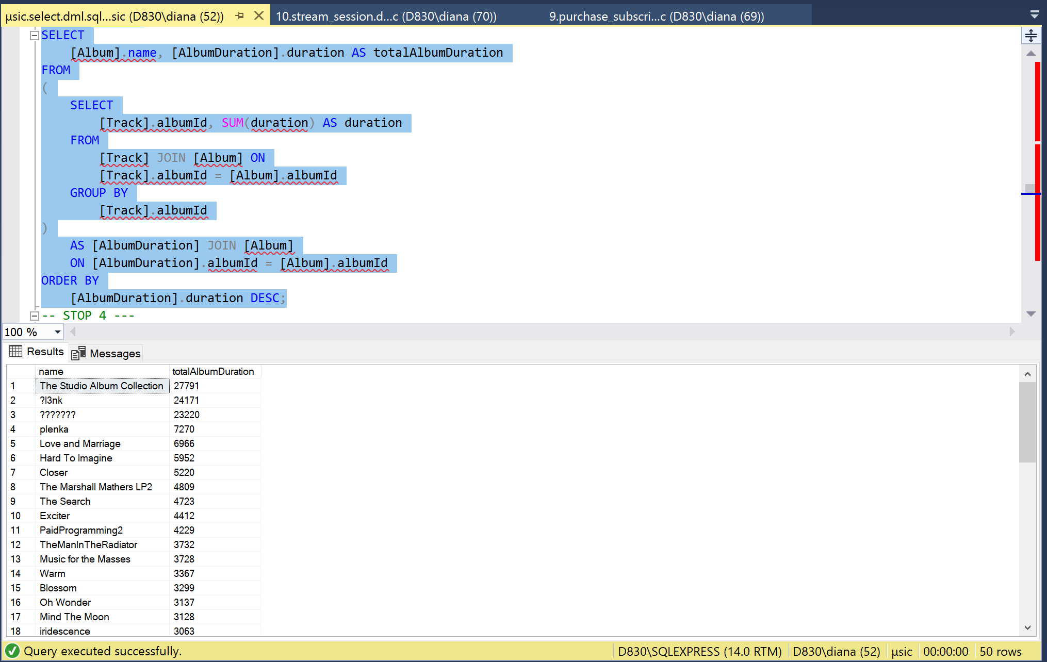
Business Analytics and Big Data Systems
Data infrastructure for music streaming services
Query for counting album lengths

Slide 20
Business Analytics and Big Data Systems
Data infrastructure for music streaming services
Deactivate User trigger
Deactivate User trigger allows us to make the user inactive instead of deleting the user, this helps us to save all the necessary information about our service.
CREATE TRIGGER DeactivateUser
ON [User] INSTEAD OF DELETE
AS
BEGIN
DECLARE @userId INT;
SELECT @userId = userId FROM DELETED;
UPDATE [StreamSession] SET isActive = 0 WHERE userId = @userId;
UPDATE [User] SET isActive = 0 WHERE userId = @userId;
END;
GO

Slide 21
Business Analytics and Big Data Systems
Data infrastructure for music streaming services
Function for making recommendations
CREATE FUNCTION GetRecommendations (@playlistId INT)
RETURNS TABLE
AS
RETURN
WITH [tracks] AS (
SELECT
[Track].trackId, [Track].artistId, [Album].artistId albumArtistId, [Album].genreId albumGenreId
FROM
[PlaylistTrack] JOIN [Track] ON [PlaylistTrack].trackId = [Track].trackId
JOIN [Album] ON [Track].albumId = [Album].albumId
JOIN [Genre] ON [Album].genreId = [Genre].genreId
WHERE
[PlaylistTrack].playlistId = @playlistId
)
SELECT
[FullTrackMetadata].trackId
FROM
[tracks] LEFT JOIN [FullTrackMetadata]
ON [FullTrackMetadata].trackId != [tracks].trackId AND (
[FullTrackMetadata].artistId = [tracks].artistId
OR [FullTrackMetadata].albumGenreId = [tracks].albumGenreId
OR [FullTrackMetadata].albumArtistId = [tracks].albumArtistId
);
GO

Slide 22
Business Analytics and Big Data Systems
Data infrastructure for music streaming services
Database formation
Snowflake cloud data system
Cost-effectiveness
High Performance
Unlimited storage capacity
Automation
Mobility
High reliability and data security
Availability
Elasticity

Slide 23
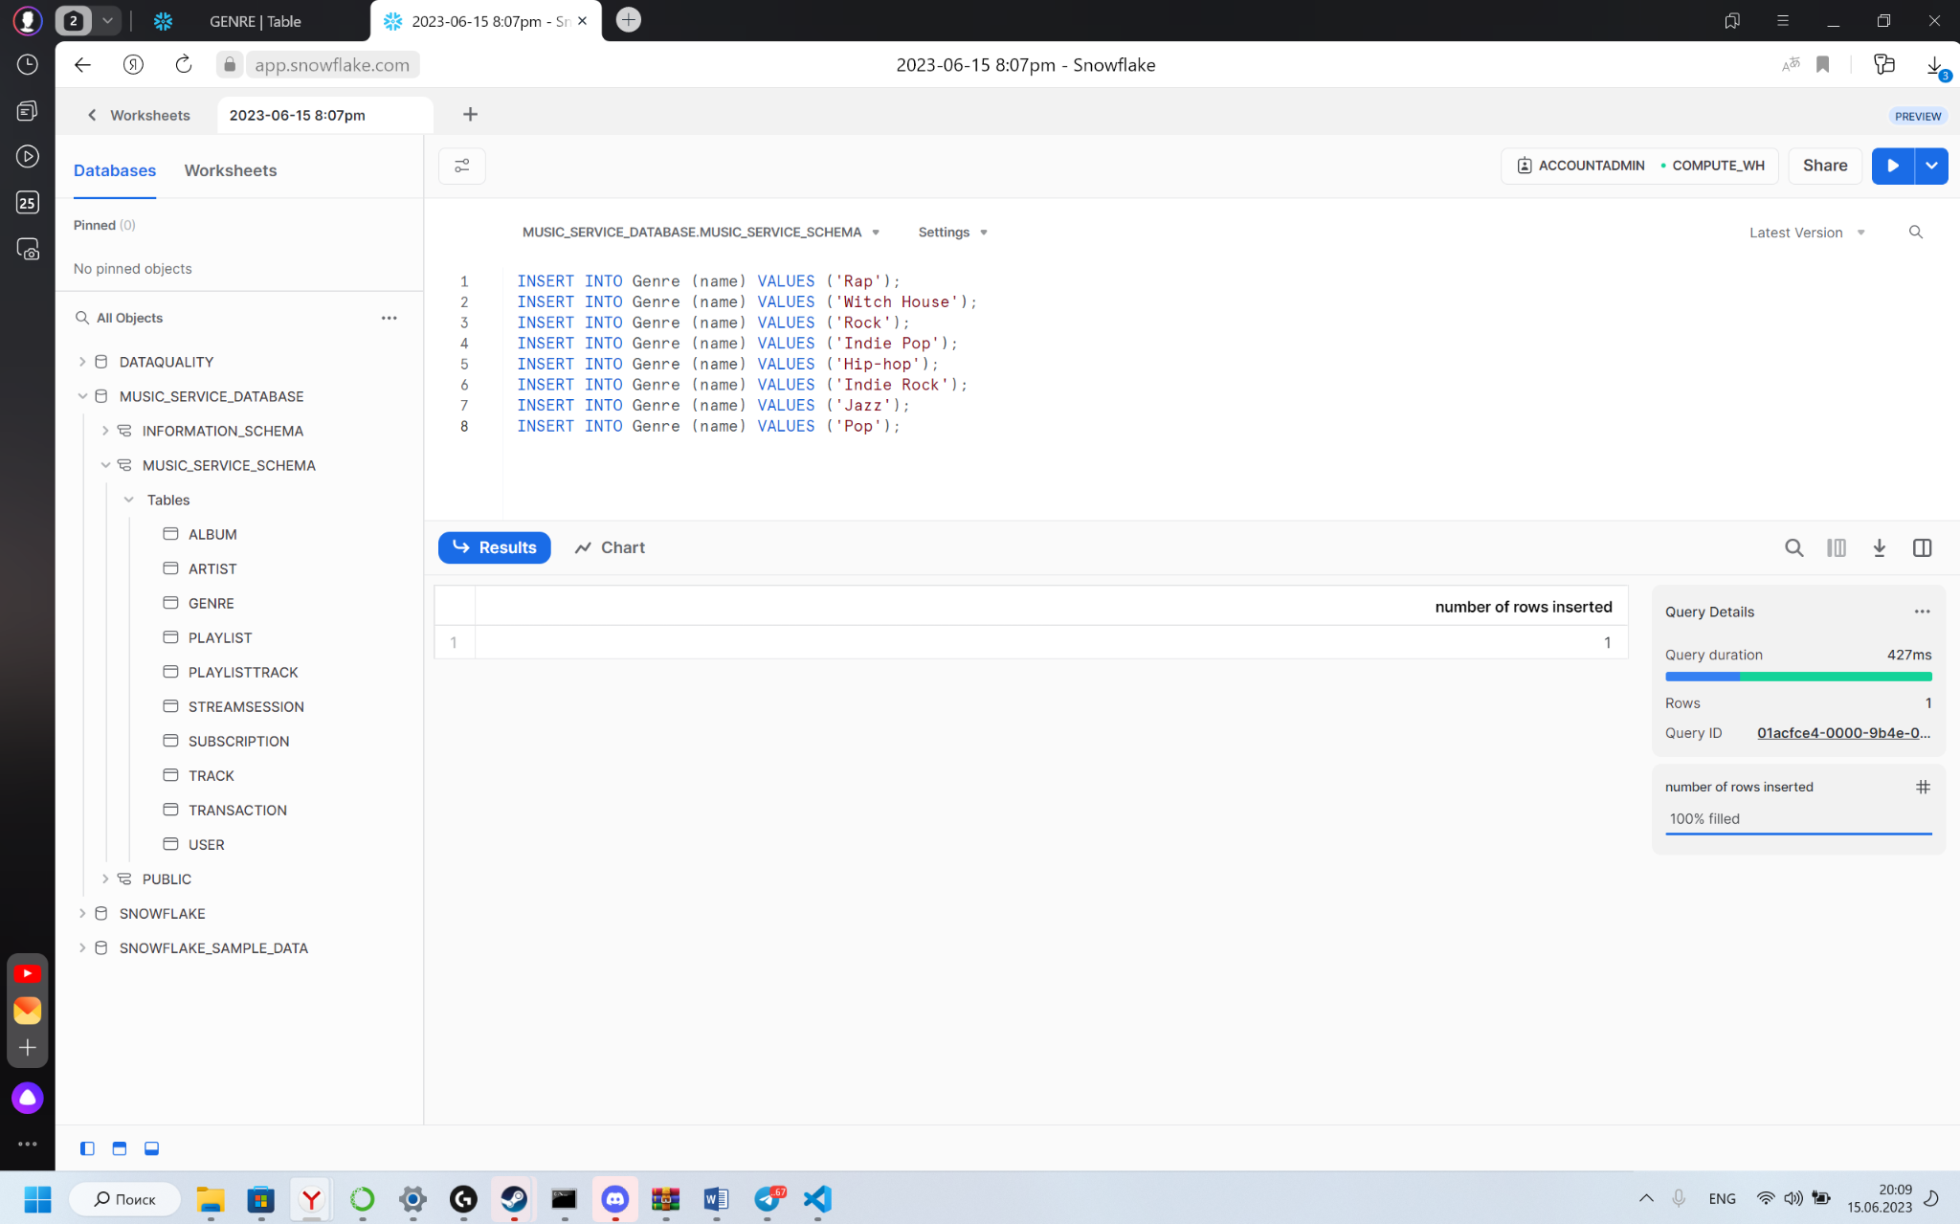
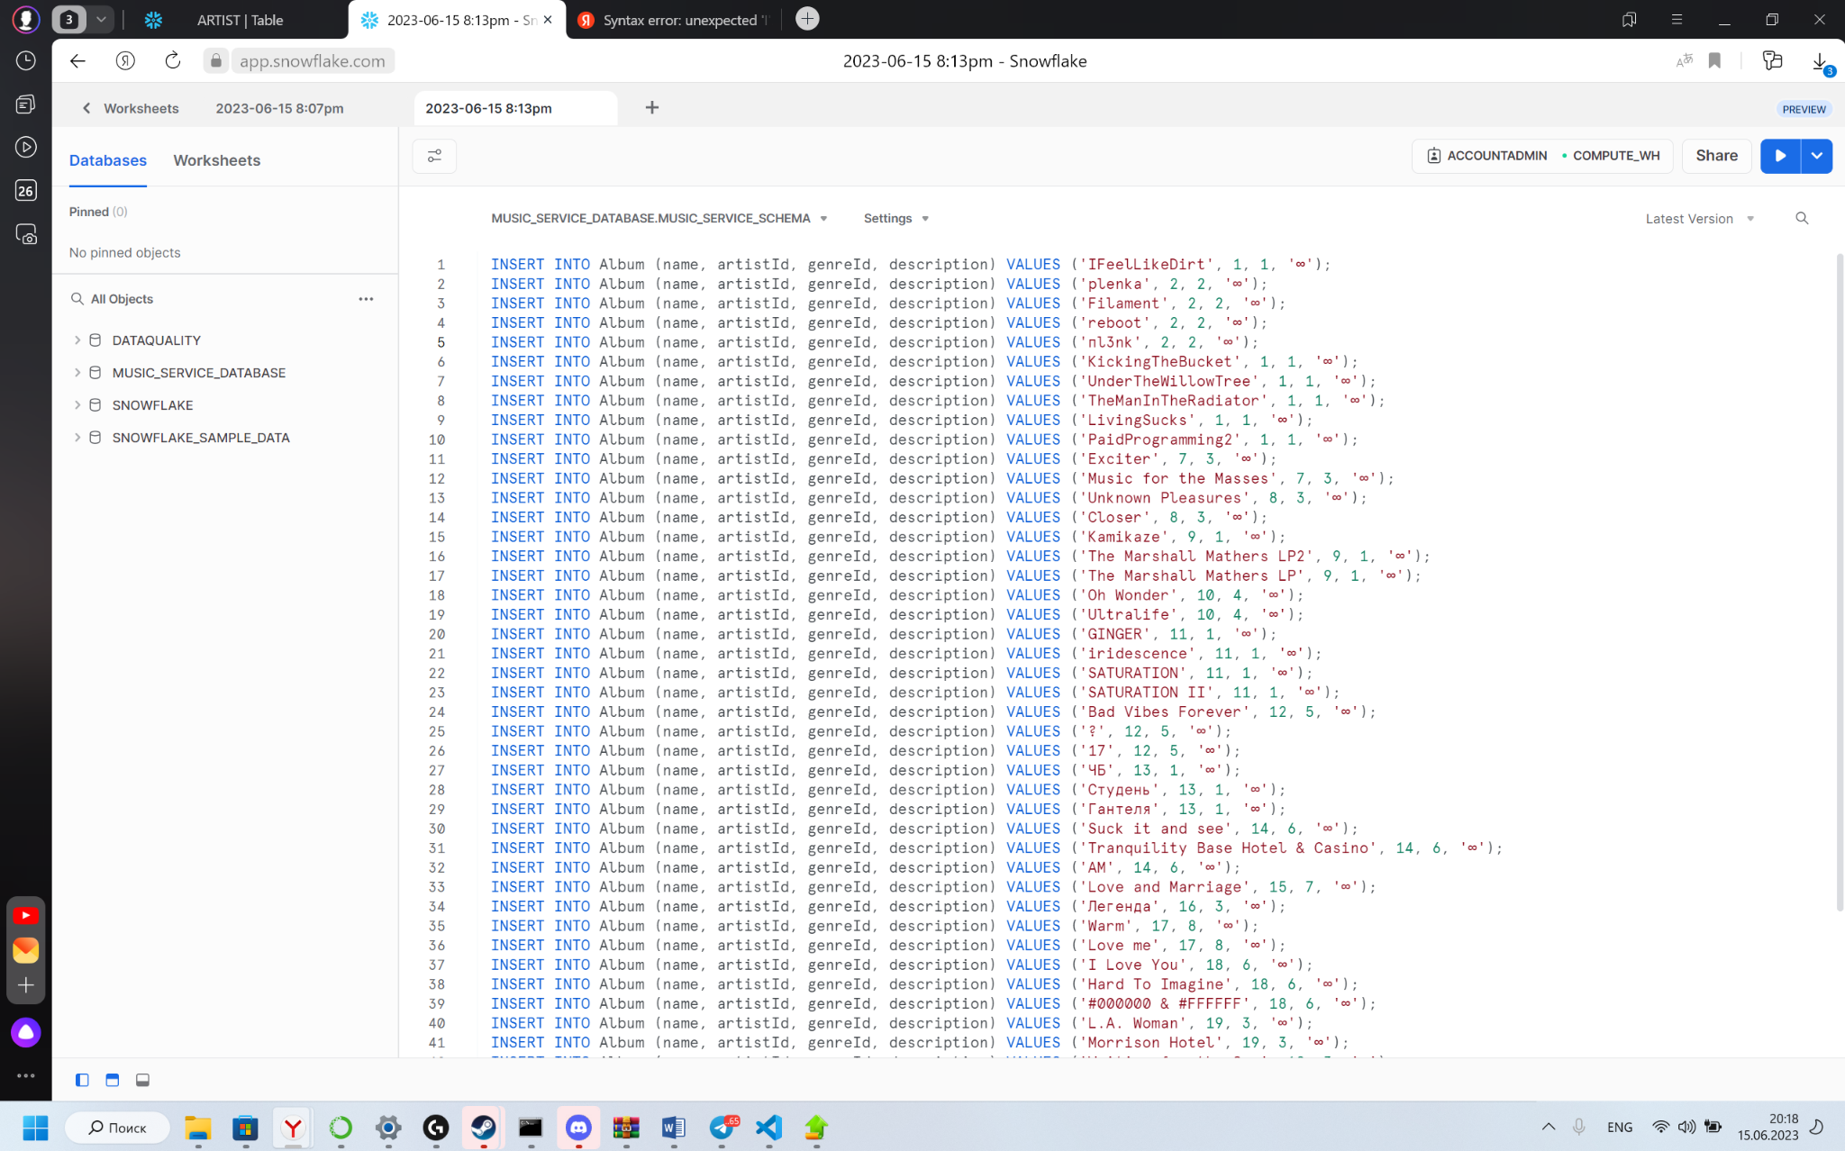
Business Analytics and Big Data Systems
Data infrastructure for music streaming services
Database data
Generes data
Albumbs data

Slide 24
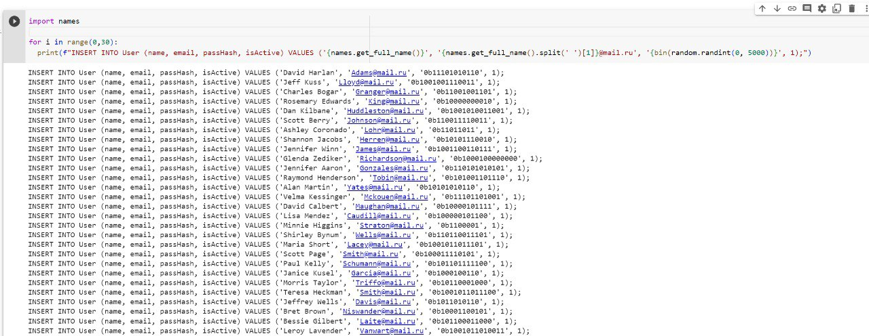
Business Analytics and Big Data Systems
Data infrastructure for music streaming services
Database data
Users’ data

Slide 25
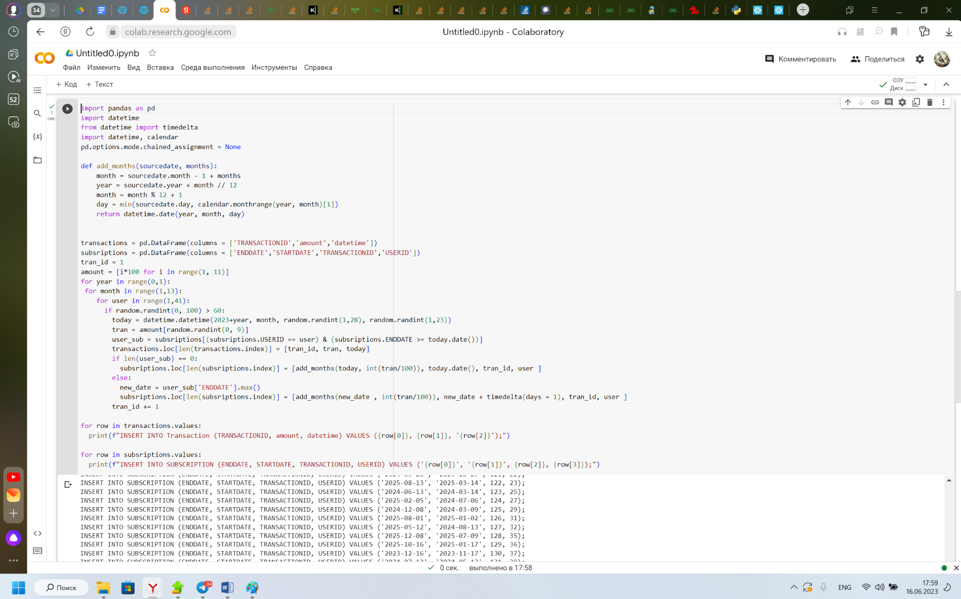
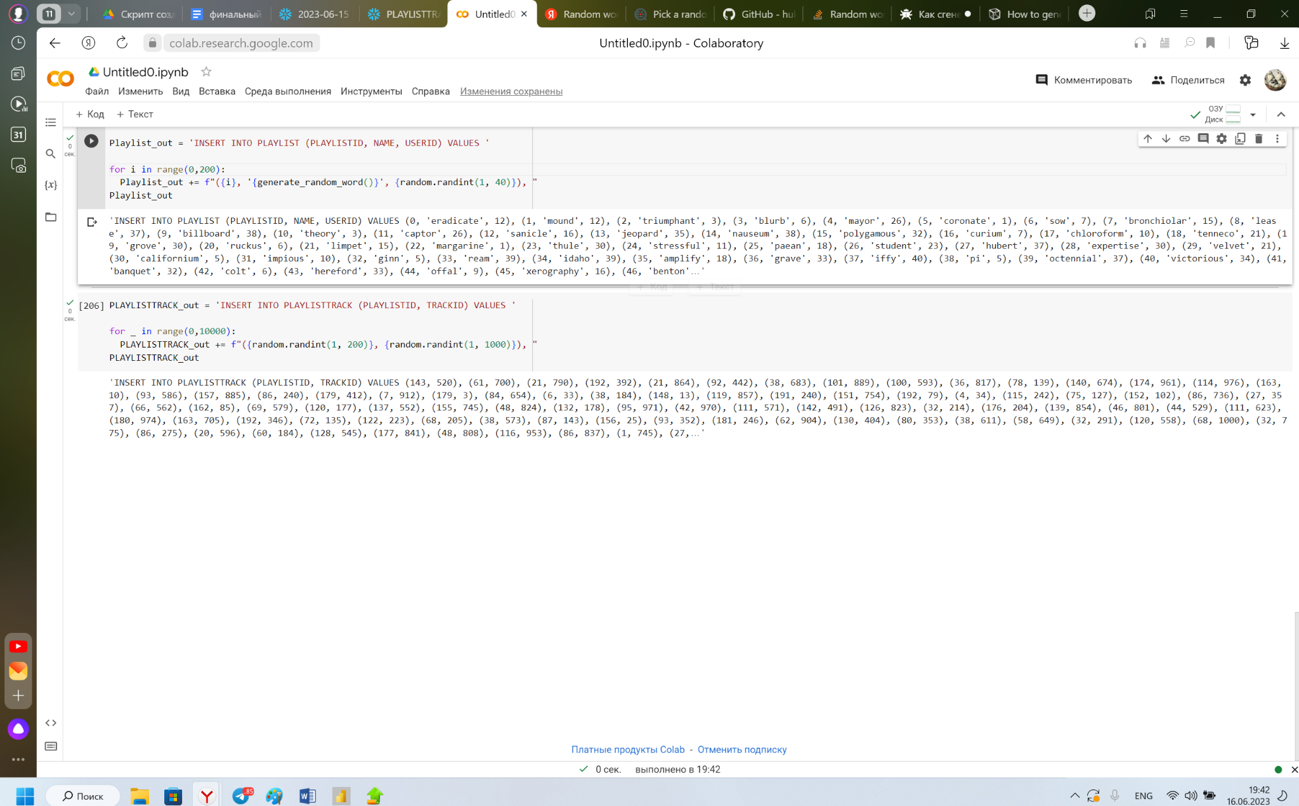
Business Analytics and Big Data Systems
Data infrastructure for music streaming services
Database data
Track data
Transaction and subscription data

Slide 26
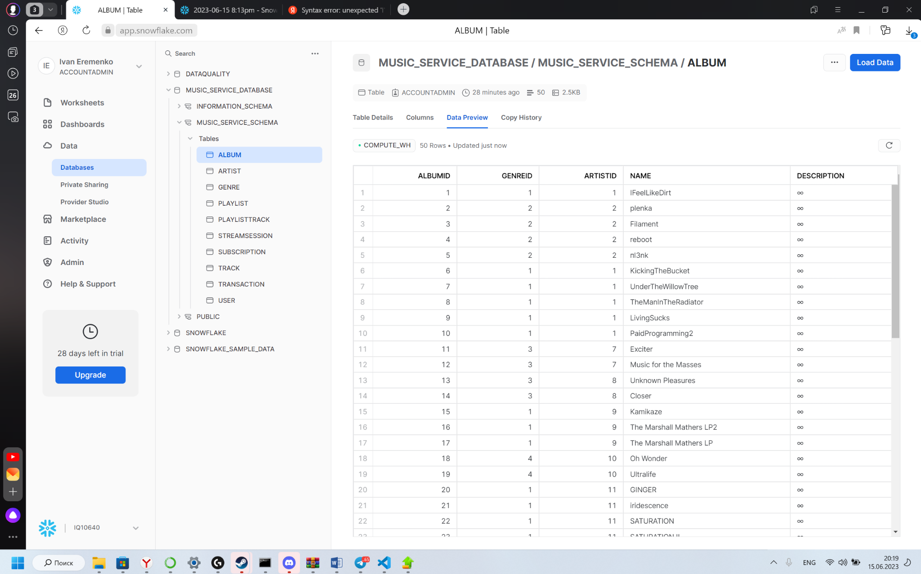
Business Analytics and Big Data Systems
Data infrastructure for music streaming services
Database data

Slide 27
CRUD matrix
Business Analytics and Big Data Systems
Data infrastructure for music streaming services
Moscow 2023

Slide 28
Business Analytics and Big Data Systems
Data infrastructure for music streaming services
CRUD Matrix
 | Admin | Worker | Musician | User | Guest
Track | CRUD | R | CRUD | R | R
Artist | CRUD | R | CRUD | R | R
User | CRUD | R |  | CRU
Album | CRUD | R | CRUD | R | R
Genre | CRUD | R | R | R | R
Playlist | CRUD | R | R | CRUD | R
Subscription | CRUD | R |  | CRUD
Transaction | RUD | R |  | CR
Data to roles

Slide 29
Business Analytics and Big Data Systems
Data infrastructure for music streaming services
CRUD Matrix
 | Admin | Worker | Musician | User | Guest
Create account | CRUD |  | CRUD | CRUD | C
Upload track | CRUD |  | CRUD
Listen to track | CRUD |  | R | R
Add playlist | CRUD | R |  | CRUD
Make a transaction | RUD | R |  | CR
Add track to album | CRUD | R | CRUD
Create subscription | RUD | R |  | CRUD
Receive personal client data | RUD |  | C | C
Activities to roles

Slide 30
Master data standards
Business Analytics and Big Data Systems
Data infrastructure for music streaming services
Moscow 2023

Slide 31
Business Analytics and Big Data Systems
Data infrastructure for music streaming services
Master data standards
Entity Definitions: Each entity should have a clear definition, including its purpose, scope, and attributes.
Data Integrity: Establish rules and standards to ensure data integrity: defining data types, lengths, formats, and validation rules for each attribute.
Unique Identifiers: Define unique identifiers for key entities, such as artist IDs, album IDs, track IDs, and user IDs.
Naming Conventions: Establish naming conventions for entities and attributes to ensure consistency and readability.
Data Governance: Define roles and responsibilities for data stewardship, data quality monitoring, and data maintenance processes.

Slide 32
Business Analytics and Big Data Systems
Data infrastructure for music streaming services
Master data standards
Standardized Codes and Classifications: Define standardized codes and classifications for attributes that require predefined values.
Versioning and History: Consider incorporating versioning and history tracking for master data, especially for entities that undergo frequent updates or changes.
Data Integration and Interoperability: Ensure master data standards align with industry standards and protocols to facilitate data integration and interoperability with other systems, such as music licensing organizations, metadata providers, and external APIs.
Data Security and Privacy: Incorporate data security and privacy measures to protect sensitive master data, including user information, financial data, and intellectual property rights. Implement access controls, encryption, and data anonymization techniques as per applicable regulations and best practices.
Documentation and Data Dictionary: Maintain comprehensive documentation and a data dictionary that describes the structure, relationships, and attributes of the master data entities.

Slide 33
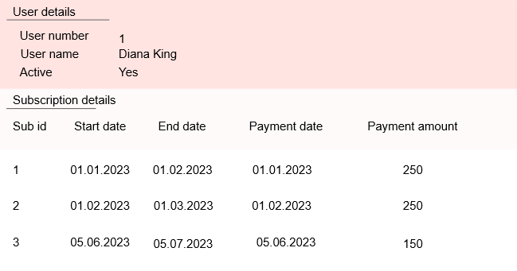
Business Analytics and Big Data Systems
Data infrastructure for music streaming services
Golden record

Slide 34
BI development
Business Analytics and Big Data Systems
Data infrastructure for music streaming services
Moscow 2023

Slide 35
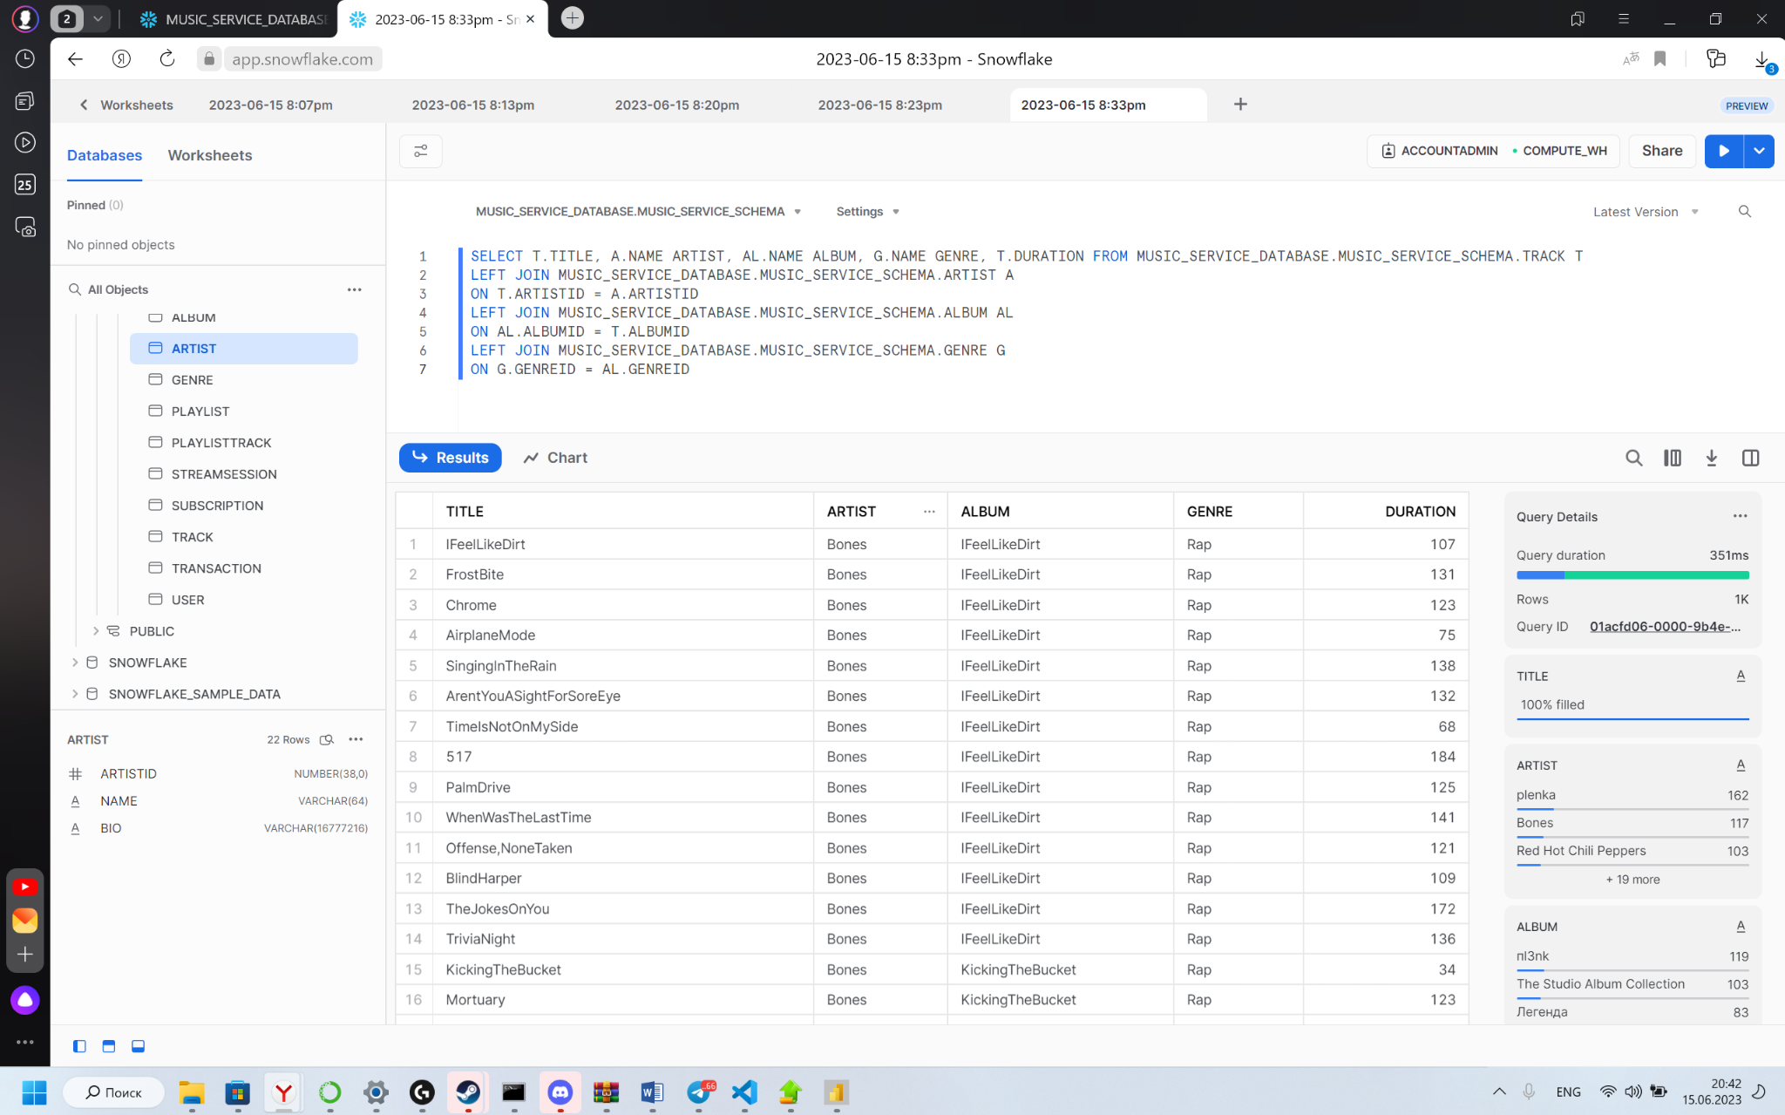
Business Analytics and Big Data Systems
Data infrastructure for music streaming services
BI development

Slide 36
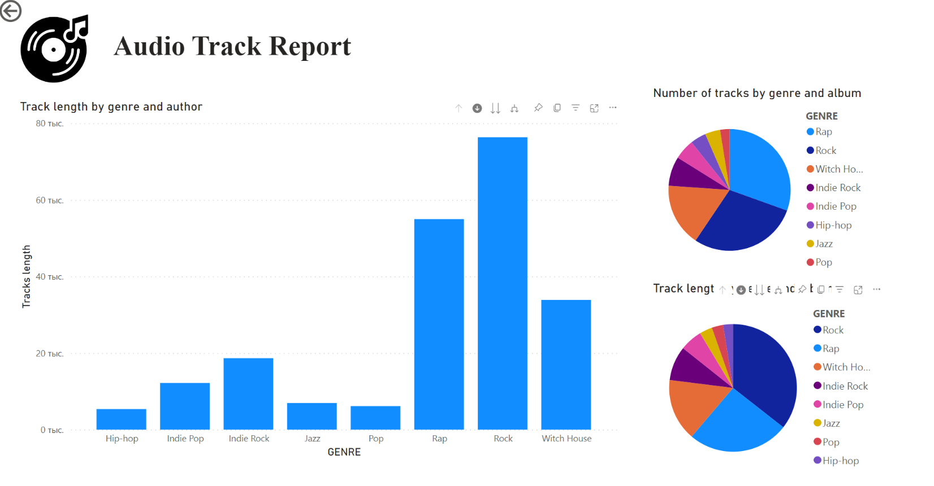
Business Analytics and Big Data Systems
Data infrastructure for music streaming services
BI development

Slide 37
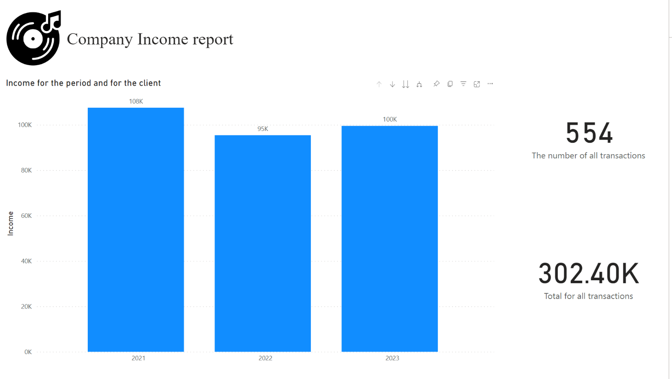
Business Analytics and Big Data Systems
Data infrastructure for music streaming services
BI development

Slide 38
Business Analytics and Big Data Systems
Data infrastructure for music streaming services
Reports
Github:
Data_Management
Report:
REPORT_DATA INFRASTRUCTURE FOR MUSIC STREAMING SERVICE
Power BI Report:
Audio Track Report
Company Income Report

Slide 39
Q&A
Business Analytics and Big Data Systems
Distributed Data Processing
Moscow 2023
Olga Goldobina – Project manager and BI engineer
Ivan Eremenko – Database engineer
Diana Shabanova – Business analyst
Vlad Maslennikov – System analyst

